Slide 1
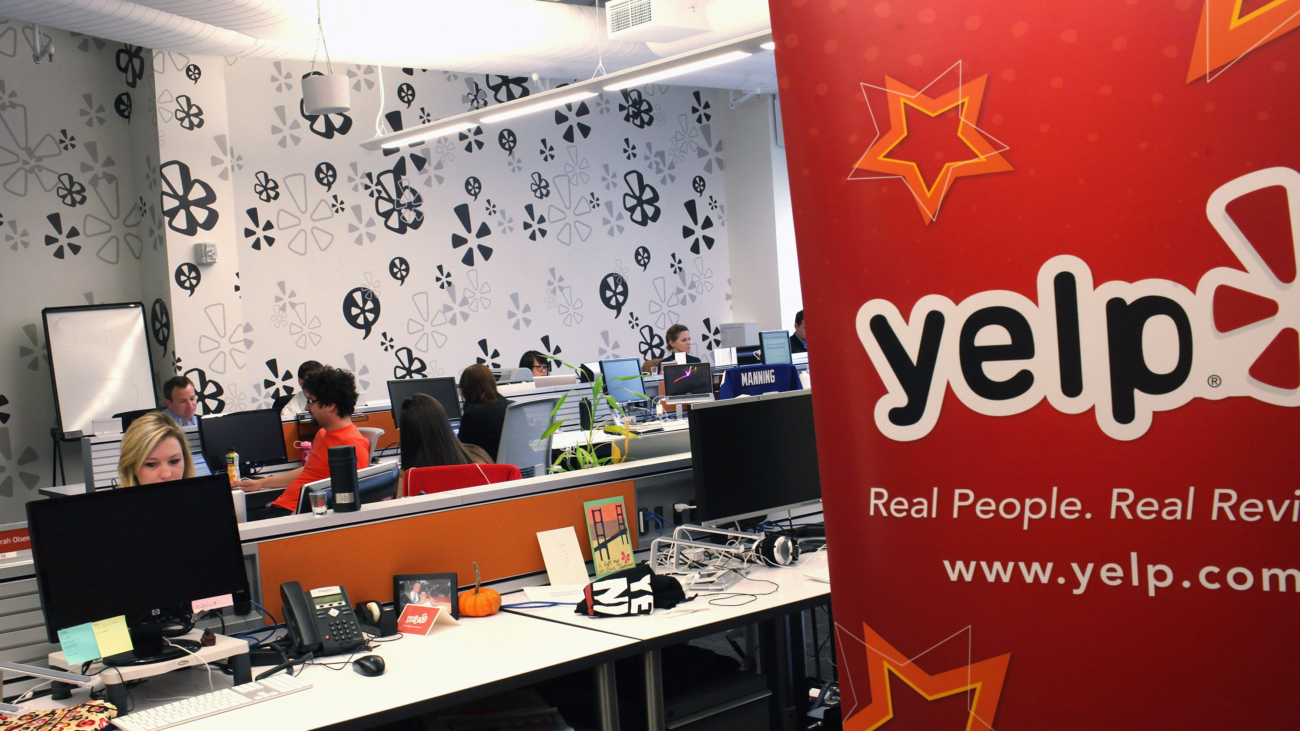
工作总结与计划
IBM DATA ANALYSIS PROJECT
General work summary report

Slide 2
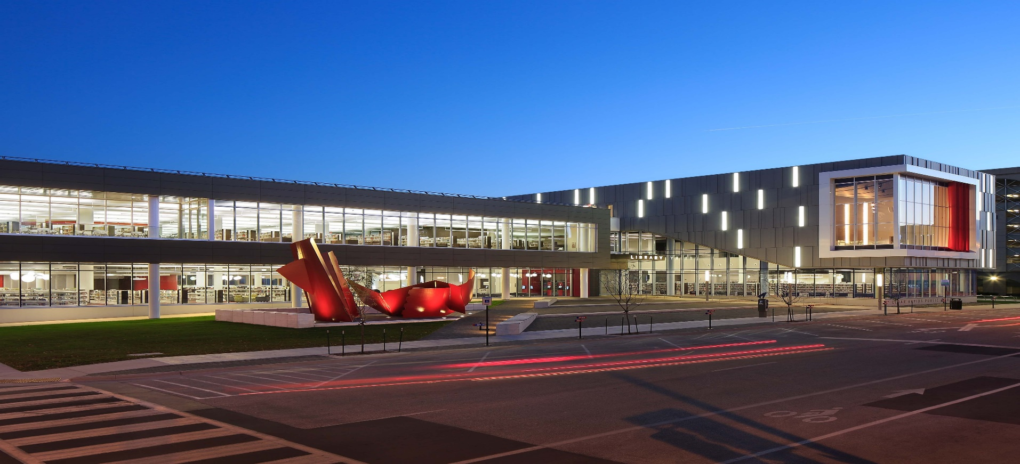
Contents
BUSINESS PROBLEMS
DATA DESCRIPTION
PROBLEMS ANALYSIS
CONCLUSION

Slide 3

PART01
COMPANY BACKGROUND
AND
BUSINESS PROBLEMS

Slide 4
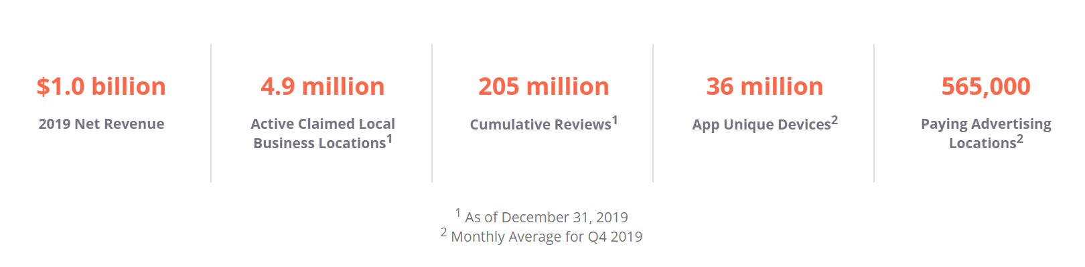
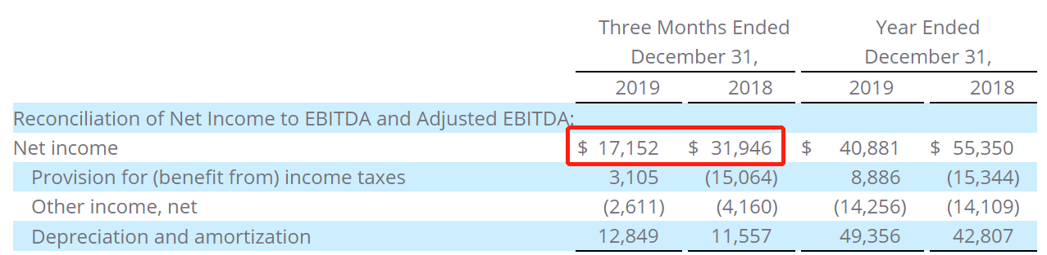
COMPANY BACKGROUND
Yelp, founded in 2004 in the United States, is a business directory service and crowd-sourced review forum. On this platform, users could review almost every type of local business, from restaurants, boutiques and salons to dentists, mechanics, plumbers and more.
In 2019, Yelp has $1.0 billion net revenue. As of December 31, 2019, it has 4.9 million active claimed local business locations and 205 million cumulative reviews. However, in 2019 Q4, although it has 36 million app unique devices and 565,000 paying advertising locations monthly, the net income of Yelp has decreased 46%, which indicates problems inside.
The company said the sharp decrease of net income was because the decreased revenue from small and medium-sized local businesses on the platform due to seasonal effects. With fewer revenue from local business, Yelp need to provide better services to these local business. There are several business problems to be solved in order to reach this goal.

Slide 5
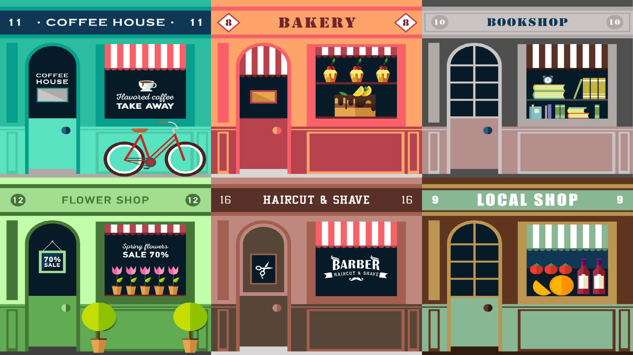
BUSINESS PROBLEMS
1
Important Features In Different Categories
Some businesses want to enter the catering industry, they want to know which categories of restaurant are more popular with users, as well as the priority of features that users will pay attention to.
Yelp can provide suggestions for the business who wants to enter the catering industry, thereby increasing the business settled rate and increasing net income.

Slide 6

BUSINESS PROBLEMS
2
How To Predict User Sentiment
The merchant cannot predict the emotional fluctuations of users, so they cannot make emergency plans or optimization plans in advance when users have negative emotional trends, resulting in the loss of users.
With the prediction, businesses can have better control and preparation of user expectations. In addition, users can also choose the appropriate restaurant according to the prediction results, which can increase the user's dependence on yelp. Therefore, it can achieve a win-win situation for all three parties.

Slide 7
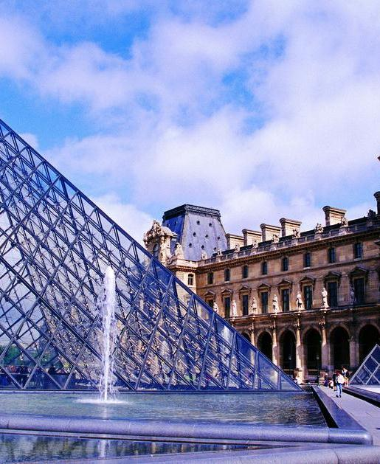
PART02
DATA DESCRIPTION

Slide 8

DATA DESCRIPTION
Business & Reviews & Tips
Business
Reviews (2004-2018)
Basic information of merchants
192,609 Samples * 13 Attributes
User reviews on the merchants
6,561,107 Samples * 13 Attributes
Users
Tips
Basic information of Yelp’s user
1,637,138, Samples * 10 Attributes
User tips on the merchants, no stars graded
1,098,324 Samples * 5 Attributes
Notes:
8

Slide 9
DATA DESCRIPTION
Yelp_Academic_Dataset_Business
 | Attributes | Description | Data Type | Example
01 | Business_id | The identifier of the merchant on Yelp | String | gnKjwL_1w79qoiV3IC_xQQ
02 | Name | The name of each merchant on Yelp | String | Musashi Japanese Restaurant
03 | City | The city of the merchant on Yelp | String | Phoenix
04 | State | The abbreviation of the state | String | AZ
05 | Postal_code | The postal code of the merchant’s location | String | L5R 3E7
06 | Latitude | The latitude of the merchant’s location | Numeric | 43.6054989743
07 | Longitude | The longitude of the merchant’s location | Numeric | -112.0184807
08 | Stars | The overall rating of the merchant, from 1 to 5 | Numeric | 3.5
09 | Review_count | The number of the reviews of the merchant | Numeric | 170
10 | Is_open | Whether the merchant is open or not | Dummy | 1
11 | Attributes | The services or facilities available in the merchant | String | {'BusinessAcceptsCreditCards': 'True'}
12 | Categories | The business categories of the merchant | String | Bakeries, Food
13 | Hours | The business hours of the merchant | String | {'Monday': '9:0-17:0', 'Tuesday': '9:0-17:0'}
Notes:
9

Slide 10
DATA DESCRIPTION
Yelp_Academic_Dataset_Review
 | Attributes | Description | Data Type | Example
01 | Review_id | The identifier of the review on the merchant | String | 4bUyL7lzoWzDZaJETAKREg
02 | User_id | The user that wrote the review | String | _N7Ndn29bpll_961oPeEfw
03 | Business_id | The merchant of the review | String | y-Iw6dZflNix4BdwIyTNGA
04 | Stars | The score that the user give on the merchant, from 1 to 5 | Numeric | 3
05 | Useful | The times that other users thought this review was useful | Numeric | 5
06 | Funny | The times that other users thought this review was funny | Numeric | 2
07 | Cool | The times that other users thought this review was cool | Numeric | 6
08 | Text | The content of the review | String | Dinner was fantastic! Service was great.
09 | Date | The date of the user posted the review | Date | 2014/6/27
10 | Time | The time of the user posted the review | Date | 21:19:23
11 | Year | The year of the user posted the review | Date | 2014
12 | Month | The month of the user posted the review | Date | 6
13 | Day | The day of the user posted the review | Date | 27
Notes:
10

Slide 11
DATA DESCRIPTION
Yelp_Academic_Dataset_Users
 | Attributes | Description | Data Type | Example
01 | User_id | The user of Yelp | String | _N7Ndn29bpll_961o
02 | Name | The name of the user | String | Nancy
03 | Review_count | The total amount of the user reviews | Numeric | 3
04 | Useful | The total times that other users thought the review was useful | Numeric | 5
05 | Funny | The total times that other users thought the review was funny | Numeric | 2
06 | Cool | The total times that other users thought the review was cool | Numeric | 6
07 | Fans | The number of the user‘s followers | Numeric | 39
08 | Average_star | The mean of the user’s historical rating | Numeric | 3.95
09 | Yelping_since_date | The date of account registration | Date | 2013/10/08
10 | Friend_count | The number of the user’s friends | Numeric | 24
Notes:
11

Slide 12
DATA DESCRIPTION
Yelp_Academic_Dataset_Tip
 | Attributes | Description | Data Type | Example
01 | Text | The user tips on the merchant | String | Best Asian food in Phoenix.
02 | Date | The date of the user posted the tips | Date | 2016/10/12
03 | Business_id | The merchant of the tip | String | 4bUyL7lzoWzDZaJETAKREg
04 | User_id | The user that wrote the tip | String | _N7Ndn29bpll_961oPeEfw
05 | Compliment_count | The compliment counts below the tip | Numeric | 0
Notes:
12

Slide 13
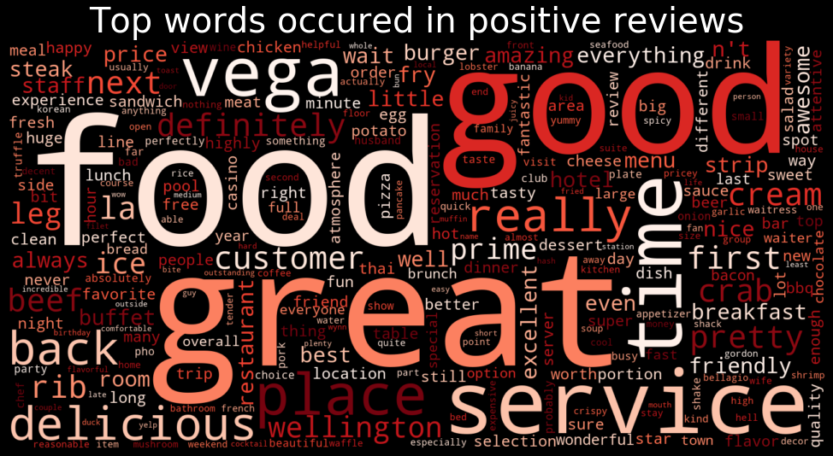
BUSINESS DASHBOARD

Slide 14
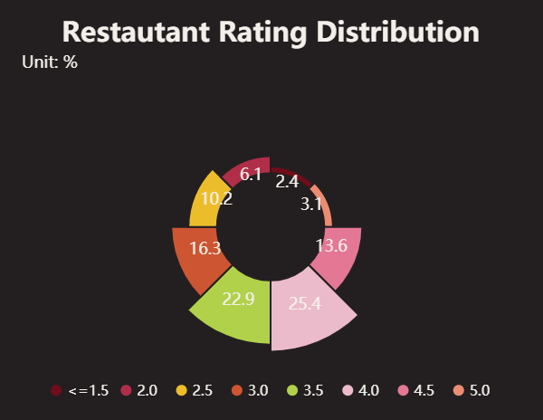
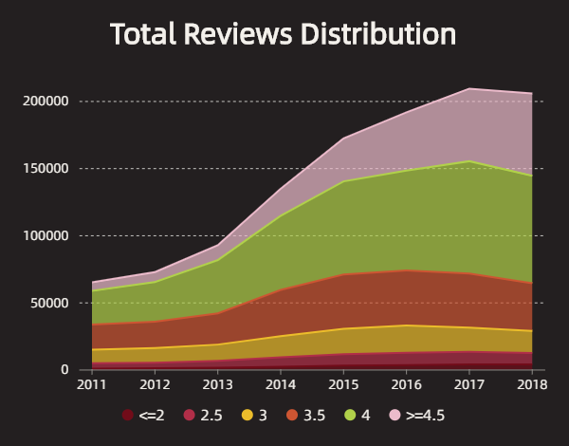
Data Visualization
City: Las Vegas with 6,450 restaurants

Slide 15
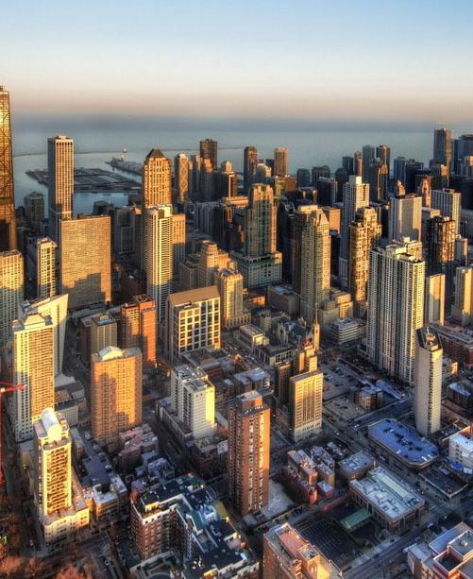
PART03
PROBLEMS ANALYSIS

Slide 16
1
PROBLEMS ANALYSIS
Important Feature In Different Categories

Slide 17

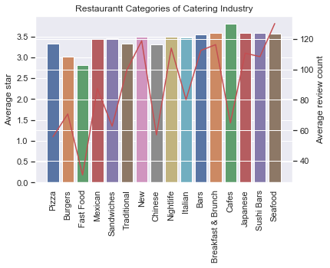
PROBLEMS ANALYSIS
Important Feature In Different Categories
Category Recognition
What categories of restaurant are POPULAR?
High average stars
High average review count
6 categories were chosen:
Seafood
Bars
American_New
Nightlife
Japanese
Breakfast & Brunch
Notes:
For the second problem, we want to find out important features in different categories from catering industry. Firstly, we should recognize popular topics of restaurants. Using variables including Stars, Review_count, and Categories in the Business Table, we calculate the average values and set the selection standards of high average stars and high average review count.
Based on our standards, at first, 6 categories were chosen to do the text analysis, including Seafood, Bars, American_New, Nightlife, Japanese, and Breakfast & Brunch.

Slide 18
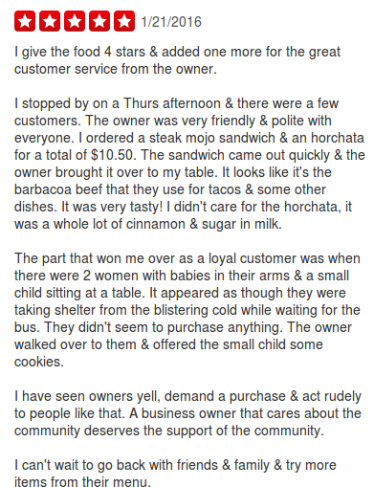
PROBLEMS ANALYSIS
Important Feature In Different Categories
Review Selection
Standards:
Stars of the review:
5-star Review → Contain the reason why the restaurant is popular.
Review length:
>= Average review length → Richer and more detailed information
Sample: 5-star long review
Notes:
To get valuable and meaningful information of each category, we consider two standards. First is the stars of the review, we choose 5-star reviews for it may contain the most reason why the restaurant is popular. Second is the review length, we choose reviews whose lengths are larger than the average review length for there it might have richer and more detailed information.
These standards are applied to each chosen category. At last, each category of restaurants has 10 thousand to 20 thousand reviews selected.

Slide 19

PROBLEMS ANALYSIS
Important Feature In Different Categories
Basic Natural language processing
Tokenization, normalization(lower case)
Weighting of term
Lemmatization and Stemming
Feature extraction
Set n_gram range
Notes:
Then we do the basic natural language processing.
For text part, first we use word Tokenization to divide a large piece of continuous text into distinct bag of words.
Stemming could help cutting the words to their root form.
Then we set the n-gram range from 3-5 to get phrases from the text. which is common length for food and services names.
After that, Convert term into matrix and weighting them.
All these actions were done in Python.

Slide 20
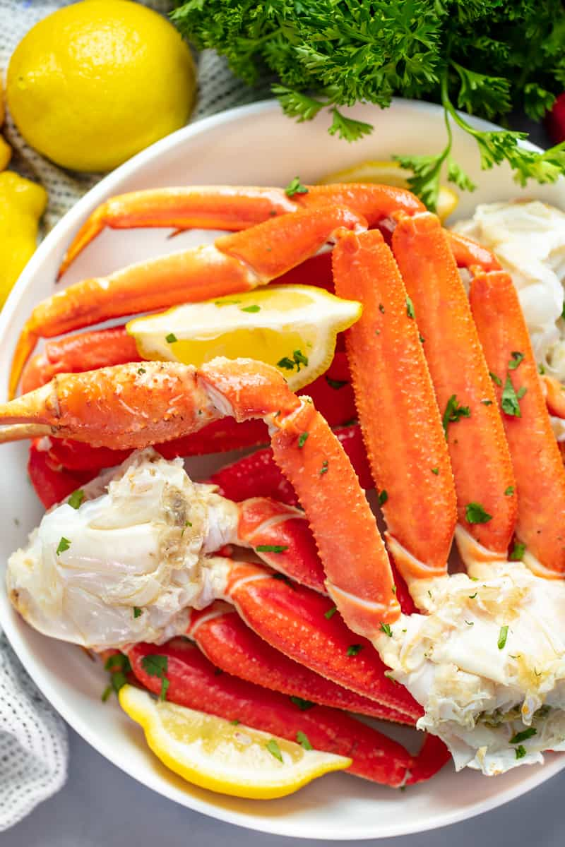
PROBLEMS ANALYSIS
Important Feature In Different Categories
Seafood Restaurants
Insights:
Apart from popular seafood, seafood restaurant could also pay attention to fry food and dim sim.
Provide tasting menu and complimentary dish would help increase customer satisfaction.
Notes:
We calculate the TF-IDF value of phrases in reviews of chosen categories. Here are the results from 3 categories which have meaningful and valuable information.
The first category we would talk about is Seafood restaurants.
The left graph shows top popular food and drink of seafood restaurant, including (1) typical seafood like plate crab leg (see picture1), whole grilled lobster, salmon poke, and fry food and Dim sim
The right graph shows us recommended services from reviews: signature tasting menu, seasonal tasting menu, and complimentary dish from the chef.
Tasting menu(see picture3) is a collection of several dishes in small portions, served by a restaurant as a single meal.
From these graphs, we could provide new entrants with insights that:
Apart from popular seafood like plate crab leg, seafood restaurant could also pay attention to fry food and dim sim.
Provide tasting menu and complimentary dish would help increase customer satisfaction.

Slide 21
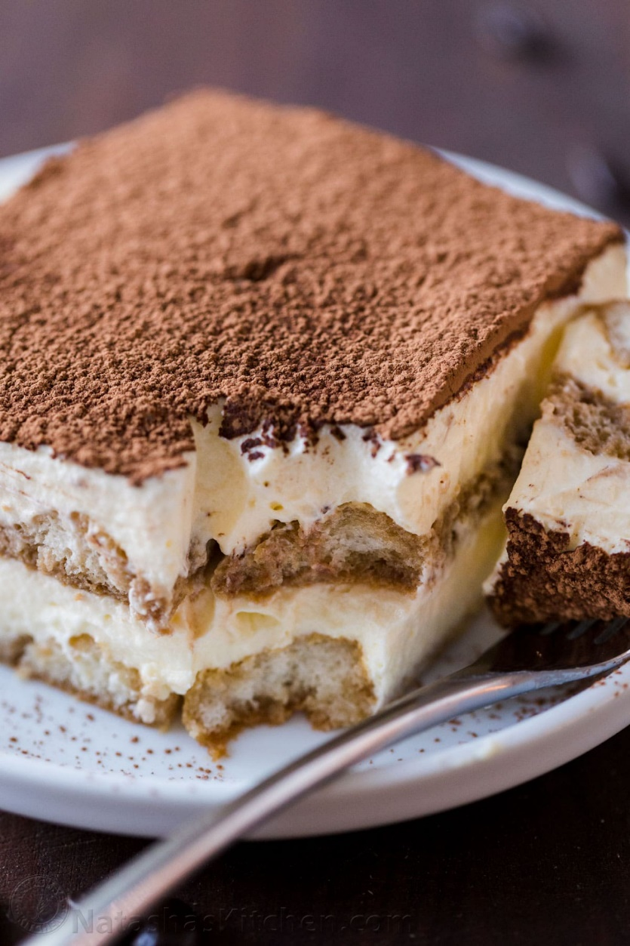
PROBLEMS ANALYSIS
Important Feature In Different Categories:
Bars
Insights:
For food, Bars could pay attention to desserts and leisure food.
For services, pay attention to recreation activities and music played in the bar, with hip hop recommended.
Notes:
Then is the category of Bars.
From the two graphs, we could provide insights that:
For food, Bars could pay attention to desserts (tiramisu(picture), boba tea, rain drop cake) and leisure food (date, chocolate croissant, fish and chip).
For services, pay attention to recreation activities and music played in the bar, with hip hop recommended.

Slide 22
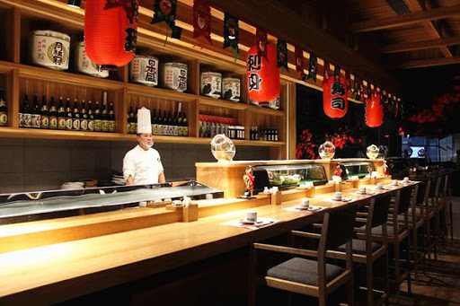
PROBLEMS ANALYSIS
Important Feature In Different Categories
Japanese Restaurant
Insights:
For food, sushi and ramen are recommended.
For services, pay attention to atmosphere and staff.
Notes:
As you can see from the chart, traditional Japanese dishes such as sushi and ramen are most recommended by customers. Fresh ingredients and traditional Japanese dishes are common characteristics of high-scoring Japanese restaurants.
In addition, the environment and service of Japanese restaurants are also extremely important. In many cases, one of the important purposes for people choosing Japanese restaurants is to enjoy such Japanese-style service.

Slide 23
2
PROBLEMS ANALYSIS
User Sentiment Analysis and Prediction

Slide 24
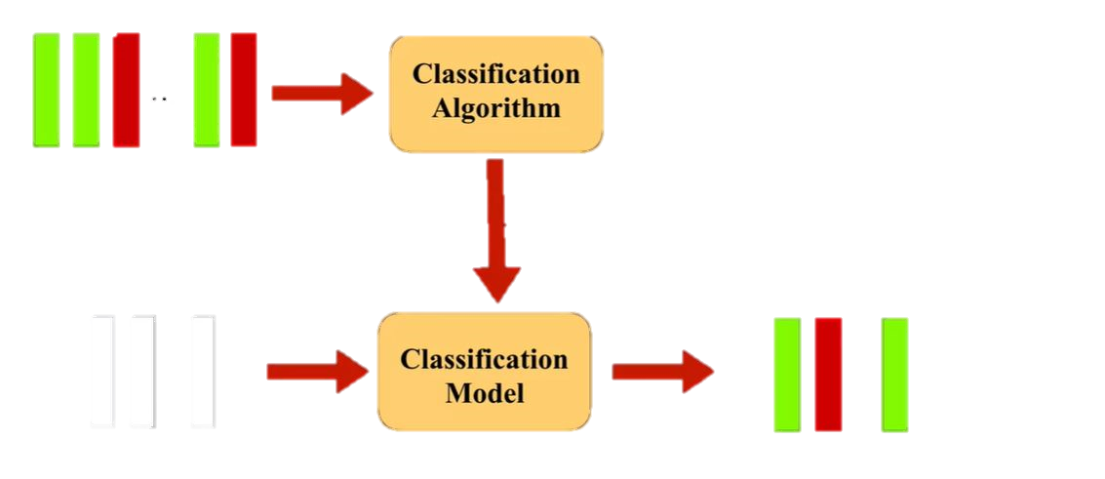
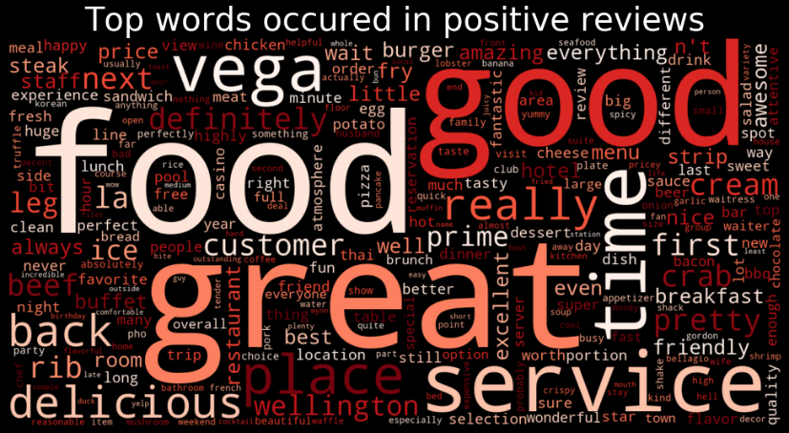
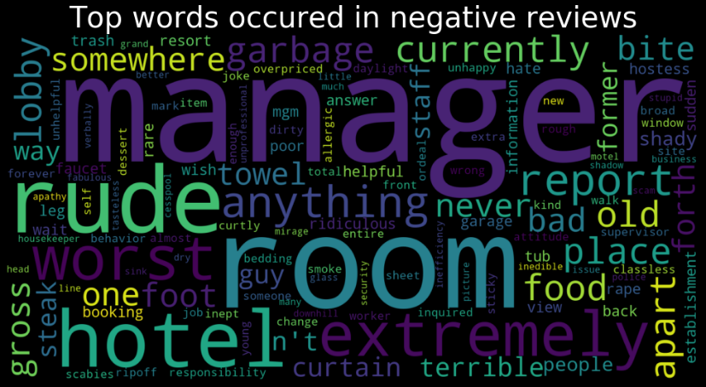
PROBLEMS ANALYSIS
User Sentiment Analysis and Prediction
Classification criteria:
> 3 star -> positive(1)
< 3 star -> negative(0)
Naïve Bayes Classifiers
Random Forest
Logistic Regression
Multi-layer Perceptron Classifier
…
Labeled Reviews
Training Phase
Test Phase
…
…
Unlabeled Tips
Notes:
Since many words in user review and tips contain a lot subjective emotion, so we try to combine sentiment analysis with text classification to dig out which words may contain positive emotion, and which words contain negative. For training phase, we have the rating review as input and feed it into a classification algorithm.
For classification criteria, we label reviews above 3 star rating as positive review and below 3 star as negative review.
We use four classification algorithms and choose one best to learn and build a model for unlabeled tips. it can give out which tips are positive and which are negative.

Slide 25
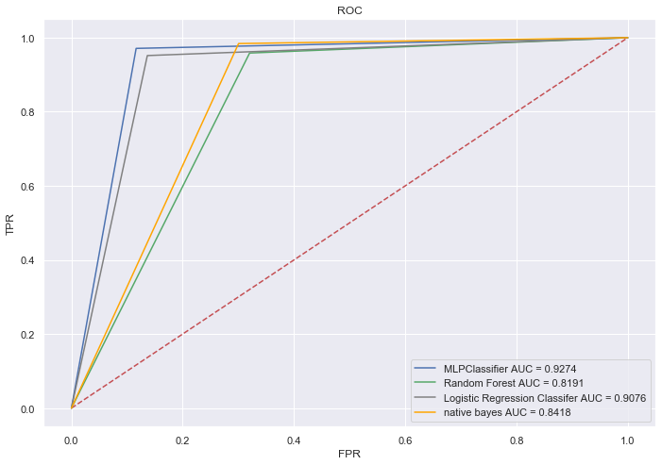
PROBLEMS ANALYSIS
User Sentiment Analysis and Prediction
Model evaluation:
Cross validation (k=5)
Confusion Matrix
MLP Classification Model has highest AUC score(0.92)
Notes:
Here is the model evaluation, for better estimation of out-of-sample performance, we use 5-fold cross-validation. Based on the confusion matrix, we calculatie Roc-auc score and draw the ROC curve of four classification algorithms of the valid data. Obviously, Muli-layer perceptron classifier and logistic regression have higher AUC score and we choose MLP-classifier as the best model.

Slide 26




PROBLEMS ANALYSIS
User Sentiment Analysis and Prediction
Good Taste & Service
Suitable Environment
Portion Size
Menu Setting
Notes:
Let us take a look what are the top positive and negative phrases in the review through the classifier.
We can see that in positive phrases has large tfidf weight on taste & service like “healthy and delicious food” and “unpretentious coffee tasty”, “food came quick” .
From the phrases ‘great place for boisterous’ and ‘casual environment”, we can know the suitable environment is another important factor.
In negative phrases, people complain more about bad quality, portion size, ‘zero vegetarian option’ menu that fits people who have different eating habit, lose those kind of customers.

Slide 27
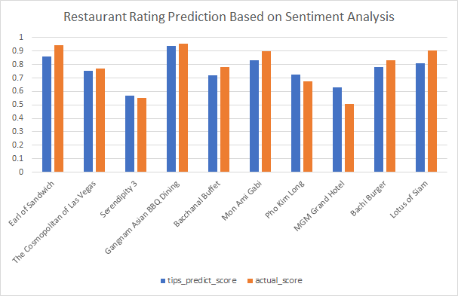
PROBLEMS ANALYSIS
User Sentiment Analysis and Prediction
Sentiment index = $mean (predict positive+negative count)$
<0.5 | 0.5-0.8 | >0.8
Disappointed | Satisfied | Very satisfied
For customer：
Identify high popular restaurants with high sentiment index
Notes:
Based on the classification model, we can define restaurant sentiment index as average of positive and negative tips prediction, if index equal to 1, which means from the tips we predict all the users recommend this restaurant and 0 means none of the user recommend this restaurant. And we compare 10 most commented restaurants the predict sentiment score and review actual score, we find there is slight differences between them, and overall the sentiment prediction is a bit lower than the actual rating, the reason could be fake reviews or advertising factor among top rating restaurant. And we define the index below 0.5 as the restaurant we do not recommend, the index between 0.5-0.8 are the satisfying restaurant, above 0.8 are hotly discussed restaurants. Therefore, customer can identify which restaurants are really recommended based on the index.

Slide 28
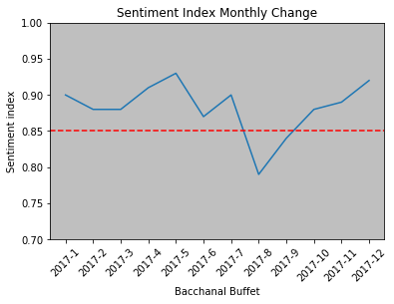
PROBLEMS ANALYSIS
User Sentiment Analysis and Prediction
For merchant:
Providing user emotional prediction for specific restaurant.
Early warning for merchant making adjustment.
Notes:
In terms of one merchant, the index fluctuation from one period to another can indicate merchant to make adjustment on business strategy. For example, a buffet restaurant with a high sentiment index over the year except a dramatically drop from July to September, which can give early warning to focus more on improving the problem and grasp hot topic changes.

Slide 29

PART04
Conclusion & Suggestion

Slide 30
Conclusion & Suggestions
Selection of popular categories of certain industry and proper reviews
Basic language processing from abundant texts to provide suggestions to businesses of certain categories
Classify sentiment from customer review and establish vocabulary library of sentiment to help decision-making for merchant
Analysis sentiment trend through topic modeling of word distribution to predict the fluctuation of customer emotions
Notes:
Early warning of potential risks

Slide 31
PPT模板下载：www.1ppt.com/moban/ 行业PPT模板：www.1ppt.com/hangye/
节日PPT模板：www.1ppt.com/jieri/ PPT素材下载：www.1ppt.com/sucai/
PPT背景图片：www.1ppt.com/beijing/ PPT图表下载：www.1ppt.com/tubiao/
优秀PPT下载：www.1ppt.com/xiazai/ PPT教程： www.1ppt.com/powerpoint/
Word教程： www.1ppt.com/word/ Excel教程：www.1ppt.com/excel/
资料下载：www.1ppt.com/ziliao/ PPT课件下载：www.1ppt.com/kejian/
范文下载：www.1ppt.com/fanwen/ 试卷下载：www.1ppt.com/shiti/
教案下载：www.1ppt.com/jiaoan/ PPT论坛：www.1ppt.cn
Thanks!
General work summary report

